Slide 1
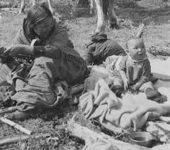
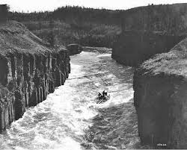
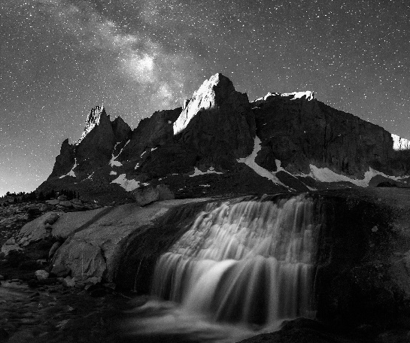
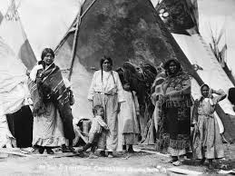
20XX & Community Name Annual Report
View>Slide Master
Insert Logo in top right corner on 2nd slide
Insert logo in footer in top slide
  Publishing this Annual Report is part of our governance process that allows the organization to review the past year and reflect on the achievements towards the strategic objectives, finalize the financial statements, and to share how the Chief and Council and all staff are interpreting achieving the strategic priorities moving forward.

Slide 2

Navigating our Annual Report
Who we are Page 3
Message from our Chief Page 4
Treaty Overview Page 5
Some interesting facts Page 6
Report on Strategic Plan Page 7
Departmental Overviews: (examples) Pages 8-12
    Administration
    Recreation
    Health
    Social Development
    Public Works
    Lands
    Education
Report on Capital Projects Page 13
Report on Risk Management Page 14
XXX 20XX Financials Pages 15-20
Type your vision statement here

Slide 3
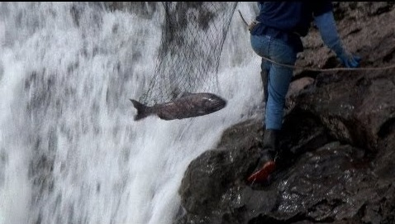
Who we are
Make this as short or long as you would like.
Insert your own pictures
Introduction of Our Community
  History
  Language
  Location
  Traditional food sources

Slide 4
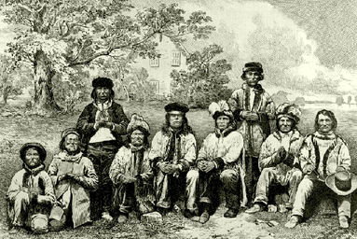
XXXX Governing Council
Message from our Chief
INSERT YOUR OWN PICS
XXX
Chief XXX
“Quote from the Chief” Chief Name
Pictures of Chief and Council with Titles

Slide 5
Treaty
Description of Community, Treaty Objectives and Process
Change chart numbers
Click on funnel which shows when click on chart, to create link to your own spreadsheet data
Fiscal Year | 2015 | 2005 | 1995
Number of Members | 891 | 728 | 553

Slide 6
Key Achievements / Milestones in the past year (examples included for reference only)
Just a few examples:
XXX,000 Elder Pmts in 20XX
XXX,000 Elder Pmts in 20XX
XXX,000 Food and Ceremonial Fish program
XXX,000 Funerals / Donations and Community Events
And in Month/20XX we released a further X,XXX,000 in member distributions related to economic development
In In Month 20XX, we had XX students graduate from Grade 12
Between Month 20XX and Month 20XX there have been approximately $X,XXX,000 in Member related Distributions
xxxx
INAC funded approximately $X,X00,000 for the XYZ project
Some interesting Facts
xxx
Our Meals on Wheels program delivers over X,X00 meals per year to targeted clients here in (First Nation name).
Own Source Revenues subsidized the completion of our new Sports Field - $XX0,000
If we were to analyze our past X years, we would see that (First Nation name) has invested over $XX,000,000 in programs and services with an additional $XX,000,000 in capital projects.

Slide 7

Report on our Strategic Plan
  A short summary of the strategic plan, such as example included for reference below:
  “Our Strategic Plan is comprised of Member Priorities, Organizational Goals and Organizational Strategies.
  This Annual Report also allows us to share how each department is taking a leadership role in building our community, either through maintenance of our infrastructure, hosting community programs, or supporting our youth.
  This Strategic Plan allows us to guide the work we do and how we allocate resources.
  We have six departments, and all departments are responsible to understand and support the outcomes listed below.”
  This past year the council and senior administration met to update the Strategic Plan.
  A full copy of our 20XX-20XX Strategic Plan is available via the membership portal on the XXX website.
(EXAMPLES) ORGANIZATIONAL STRATEGIES
Promote healthy living, provide comprehensive health services and advocate for comprehensive health services
Provide programs to strengthen our culture
Provide crime prevention, safety and enforcement services in the XXX community
Provide and strengthen infrastructure (e.g. housing, roads, and docks) and transportation services
Provide programs to improve education outcomes and employment opportunities for our members
Develop internal
management and
Leadership capacity to
support the succession of our organization
Partner with
organizations to
ensure financial
sustainability
Improve
governance and
operational
policies and
procedures to
increase
efficiency and
effectiveness of
service delivery
Improve planning
and integration
between
(First Nation name)
Departments and
Organizations

Slide 8
Administration & Finance
Update
ALL EXAMPLES FOR REFERENCE ONLY:
Summary
The administration department is a support system for all departments and is responsible for the development and implementation of policies as instructed by the Chief and Council. Last year we allocated a significant portion of technical resources to the Custom Election Code, Land Code, various community by-laws and the updating of our Financial Administration Law.
Key Accomplishments
The Financial Administration Law (FAL) is a regulatory framework on the governance of finances using best practices. When we adopted the FAL in Month 201XX, the First Nations Financial Management Board granted us a Financial Performance Certification based on our past X audits compared to industry ratios. We are now moving into the next phase which is a Finance Management Systems Certification. This is a coveted title owned by First Nations that demonstrate best practices in the application of their financial controls. In order to qualify for the best practices title, we set out to demonstrate that we deliver all the main sections of our FAL as evidenced below.
Evidence
    Active Finance & Audit Committee
    Risk Management framework completed
    Multi-year Financial Analysis completed
    Audit - available for your perusal on our website
    Annual Report - let us know if there is more content on this report you would like to see
    Policies & Procedures – Human Resource Manual updated
Reflection
  Training and hard work has given us the capacity to work through our Financial Administration Law (FAL) and all activities. We can see how best practices will benefit (First Nation name) and are looking forward to sharing how through improved transparency. Our biggest hurdle is balancing the needs of the government and the monies available to do it.
Department Strategic Alignment
  Administration supports all departments, and thus all strategic priorities. Some strategic priorities are more obvious such as “Economic Sustainability” for our community through effective management of band revenues and management of the budgets.
  EXAMPLE FOR REFERENCE ONLY
  We have been focused on all the processes and policies needed to comply with the First Nations Financial Management Board criteria for best practices certification. This work has included ensuring that we have a Strategic Plan, Risk Management Plan, Multi-Year Financial Plan and many policies for all our departments – all to provide First Nation Financial Management Board as well as ourselves the confidence that we are managing our resources effectively. This will allow us to make informed decisions about allocation of resources.
  We are looking forward to another great year. The team in Administration is excited to about all the work that we did in 2015 to increase our organizational capacity.
Costs
Chief Financial Officer for XXX

Slide 9
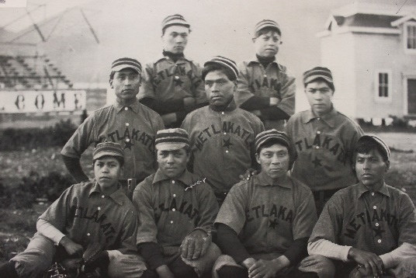

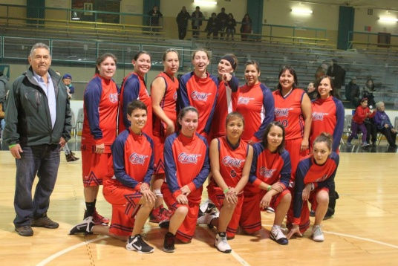
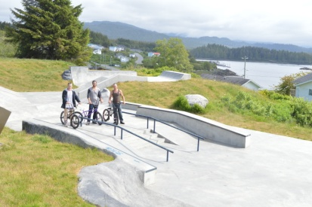
Recreation
Update
Summary
  The Recreation department’s objectives are to ensure all members have access to programs that promote healthy and active lifestyles. Programming offered at our indoor and outdoor facilities include: volleyball, basketball, skateboarding and baseball. The gymnasium is open Monday to Friday 9am – 5pm located on site at (enter location).
Key Accomplishments
The Month 201XX year end marked the completion of the new ball field, new skate park and the grand re-opening of our gymnasium for recreational use including the purchase of new sports and fitness equipment.
Evidence
We are proud to say that membership has accessed the following programs:
Reflection
This past year we have learned that the efforts put into building leadership with our Youth is immeasurable. By engaging them in sports, targeted programs and other community activities, they learn to build a stronger, empowered sense of self through healthier choices.
Department Strategic Alignment
  We are most aligned to “A Future for Our Youth” which to us means that we need to address the challenges faced by youth today in making healthy choices. We try to offer alternative programs to engage the youth. We see this to be part of the future, by building a solid foundation for our youth which will in turn , ensure that they will be preserving our resources and contributing to a sustainable Nation.
  ALL EXAMPLES FOR REFERENCE ONLY
1 | Scared Straight Progam | 2 | Employee Fit Program
3 | Coaching Clinics | 4 | Sports Camps
5 | Behavior Incentive Program | 6 | University/College Tours
7 | Sea Kayaking | 8 | Daily Gym Activities
Add your pics/graphics

Slide 10
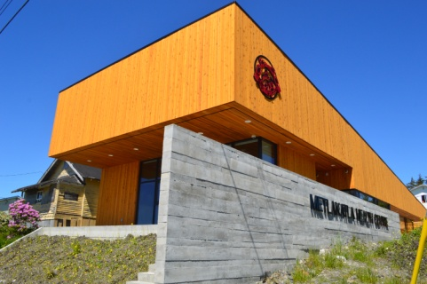
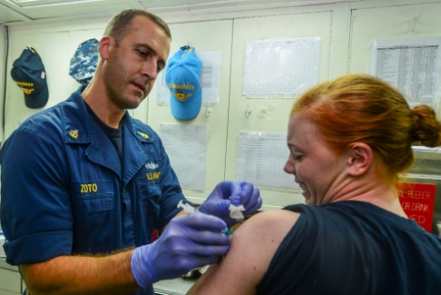
Health
Update
ALL EXAMPLES FOR REFERENCE ONLY
Summary
  The Health Department encompasses health promotion and disease prevention programs to improve health outcomes and reduce health risks. Programs include: communicable disease control and management; environmental public health; clinical and client care; first nations home and community care; health planning and management, operations and maintenance for capital facilities, solvent and drug abuse programs; mental health crisis management and aboriginal head start or daycare programs on reserve.
Key Accomplishments
Our biggest accomplishment in the past few years was the building of our geothermal health facility with a designated clinical area for visiting physicians. It is here in this beautiful facility that we are able to offer the following programs:
Evidence
    Vaccination certification
    Paperless Health - digital health records for all
    Drug and Alcohol training
    Geothermal health facility
    Emergency response plan
    Better continuity of care
Reflection
  We will continue to have some challenges in our next year, such as the need for on staff support in nursing and better understanding the programs to offer that will engage the membership.
Department Strategic Alignment
  We are most aligned to “Holistic Health and Wellness” which to us means that partnering with other departments is important to care for our clients holistically. The Health Department delivers programs to address clinical care & counselling, but we also rely on Social Development, Recreation and Education programs to also inspire our clients on an emotional, spiritual or educational level. We see this to be the way to also build a solid foundation for our members which will in turn , contribute to the essence of our community and (First Nation name) identity.
Insert pics
  Note from Health manager
Author

Slide 11

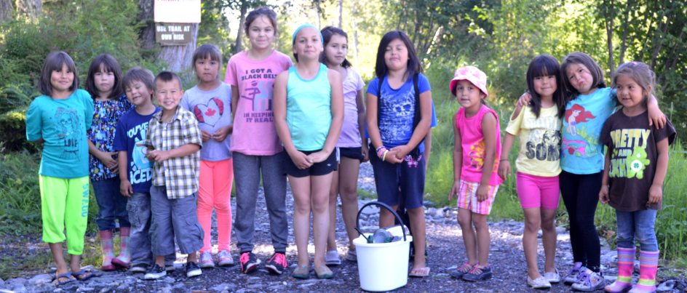
Social Development
Update
EXAMPLE FOR REFERENCE ONLY
Summary
The objectives of our Social Development Programs are to support the spiritual, mental, physical and emotional well- being of members. This holistic approach ensures that basic shelter and food are provided to low income families in need, in addition to providing services and quality programs that contribute to an enhanced quality of life.
Key Accomplishments
We are proud to say that the Month 20XX fiscal year marked the establishment of one or two programs, the contribution of funding to provide recreational programs to community members of all ages, and the continuation of programs that have been ongoing to help support those that are in need:
Social programs contributed to the renovation of the Elders Centre so that it will also be used as a Youth Centre.
Social programs contributed to the new field and skateboard park.- We have had several workshops for youth over the past year as well as for adults in the community.
Evidence
  The establishment of a Women’s Night Out group that meets regularly
  Regular AA meetings in (enter location)
  One on one counseling.
  Group counseling.
Reflection
    Are we going to be doing things differently this year not that we have learned, and we have the strategic plan guiding our effort?
Department Strategic Alignment
  Add summary here
Include message from department head here

Slide 12
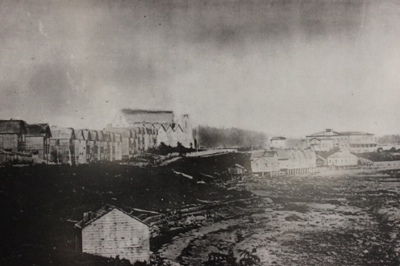
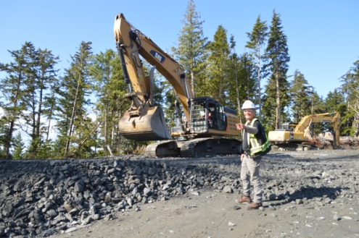
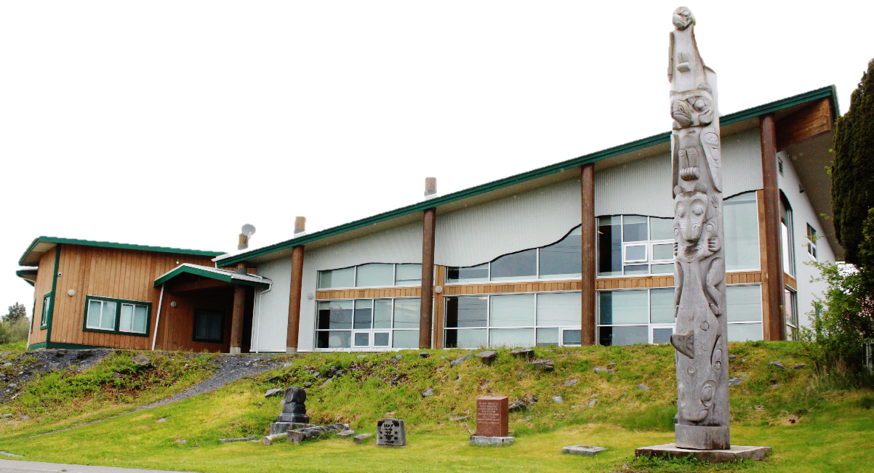
Public Works/Community Services
Update
EXAMPLE FOR REFERENCE ONLY
Summary
  Public Works includes all common infrastructure within our community such as the playground, solid waste treatment plant, and the administrative and health building.
Key Accomplishments
    Solid Waste Treatment Plant
    Built a team that is proud of working for the community
    Talked to school kids about our waste treatment plant to share the “how it works” and what types of career roles makes it tick.
Evidence
Add summary here
Reflection
  We are looking to encourage more members to consider a job working for the community, for it gives a sense of pride and accomplishment close to home.
  “The more that we can be self-sustainable, the more we can have together”
Department Strategic Alignment
  Add Description here
EXAMPLE FOR REFERENCE ONLY
  This year has been exciting, and we have managed to accomplish a lot. We can all be proud that our solid waste treatment plant is one of the best in the province, maybe even the country. We at Public Works, are working for the community to build a better, healthier, and more active environment for our members. We are looking forward to next year, as we have been approved to continue our work on a shoreline erosion project and H2O treatment project.
  We now have an asset management plan. This means that all our capital infrastructure projects will be listed and evaluated to determine where our funding can be and is best spent. These decision are very difficult at times, as funding is never enough to pay for all the project we want to do. The plan ensures that we apply a balanced approach across all of our assets.
  Looking forward to another great year!
EXAMPLES ONLY. INSERT YOUR PICS
XXX
Community Services Director

Slide 13
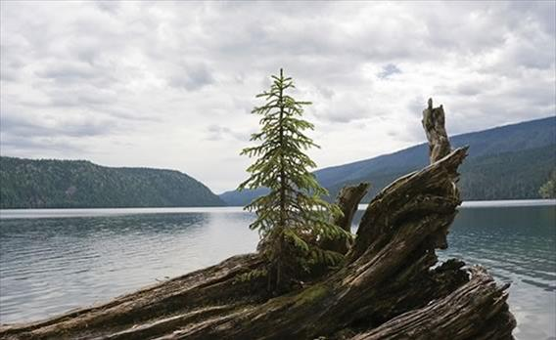
Lands
Update
Summary
  Short summary that describes this department.
Key Accomplishments (Examples for reference only)
    Draft Land Code reflected of membership input
    Hired a Lands clerk
    Completed first steps to correct errors that happened under previous Land Management
Evidence
Add examples here
Reflection
Add Description here
Department Strategic Alignment
  Add Description here
  Description of the work that has taken place over the last year

Slide 14


Education
Update
Examples for reference only
Summary
  Short summary that describes this department.
Key Accomplishments
    Summer camp for kindergarten to grade 3 that taught songs in our language, how to make drums, and the 14 steps of celebration feast
    Apprentice Master Language training
    Kids want to stay in school when they have access to language and culture as part of the curriculum
Evidence
    80% graduation rate
    14 – 16 members attend adult language classes
Reflection
  Working in education is most rewarding as providing children with the right foundation and role models can shift each child to have the self esteem to be successful. The most difficult part of the job is finding enough funding to support the necessary programs to support children and adults.
Department Strategic Alignment
  Our children and youth are our future. Through their eyes we will see our vision realized. Education is aligning its efforts to ensure that we preserve our culture and environment in a way that considers technology and progress but also instills language and traditional practices. Education is also aligned to holistic health, as through education and understanding we can support our youth with the foundational skills to become confident contributing members.
EXAMPLE FOR REFERENCE ONLY
  We have to look back before we can move forward - which means we have to look at our history. We need to learn our language as this is the foundation that will connect us together, with the land, and with ourselves. Our children are building pride in themselves and are becoming confident members with bight futures.
  The education department does a lot to build cultural understanding within the curriculum and for life skills. Education is not only the work we do to support School District XX but also we work to ensure kids have access to snacks, books when they are on the ferry, and summer camps.
  Our biggest hurdle is, and likely will always be funding. The department is writing many proposals for grants and support from various organizations.

Slide 15
CAPITAL PROJECTS:
EXAMPLE PIE CHART AND TABLE
This pie chart shows that most of our capital projects are funded through proposal writing to INAC. These proposals are successful based on cabinet’s spending priorities as outlined in their federal budget. Note that we have forecasted some spending on mitigating shoreline erosion for the 2017 fiscal year, however we may wait for several years for the project funding to become a priority at the federal level.
  EXAMPLE FOR REFERENCE ONLY
  From 20XX-20XX, (enter First Nation name) has allocated approximately $X,X00,000 of its financial resources to capital projects or purchase of capital assets.
Not all capital projects are funded by INAC, some were subsidized by own source revenues (unrestricted monies held in the General Fund).
Funder | Asset Type | Cost 2011-2016 | Forecasted 2017 | Total
INAC | Solid Waste Transfer Station | X,X00,000 |  | X,X00,00
INAC | Sewage Lagoon | X,XXX,000 |  | X,X00,00
Health CDA & OSR | Health Center | X,XXX,000 |  | X,X00,00
OSR/Port/INAC/Health CDA | Sports Field & Pavillion | X,XXX,000 |  | X,X00,00
OSR | Elders Units | X00,000 |  | X,X00,00
OSR | Admin & other public Building Reno | XXX,000 |  | X,X00,00
OSR/INAC/Health CDA | Vehicle/Vessel/Equipment & Other | XXX,500 | X00,000 | X,X00,00
INAC | Housing Assessment/Minor Repair |  | X0,000 | X,X00,00
INAC | Decommission Old Dock |  | XX0,000 | X,X00,00
OSR | Repairs to XYZ |  | X00,000 | X,X00,00
OSR/INAC | Shoreline Erosion (pending approval from INAC) |  | X00,000 | X,X00,00
Prov BC | Community Paving |  | X,000,000 | X,X00,00
INAC | Asset Mgt Plan, CCP |  | XX0,000 | X,X00,00
INAC | Water Assessment |  | XXX,000 | X,X00,00
OSR/Port | Community Greenhouse |  | X0,000 | X,X00,00
OSR = own source revenues from General Fund (unrestricted) |  | XX,000,000 | X,000,000 | XX,000,000
Some projects are not considered to be eligible under INAC funding. The below list is just a few examples of some of the projects we have subsidized from our General Fund.
$xxxxxx Project Name
Insert your data here

Slide 16
Report on Risk Management
Risk Statement as an impact to our strategic priorities | Risk Theme | Treatment plan
If we do not properly monitor and manage our lands, waters and associated resources through physically patrolling and collecting data we will not be aware of trends in species including declining numbers. | Environmental Protection | Task xxx to develop a plan to monitor, track and inventory the land & marine species to determine any fluctuations that may be related to external communities over-harvesting, or man made hazards such as increased port traffic/over-logging or global climate change.
If we do not support our Enterprise Resource Plan (Information Technology Plan) with financial resources to upgrade our network, we are at risk of compromised and/or lost electronic data. | Infrastructure | Network analysis and server/connectivity upgrade is near completion. The upgrade includes; new data server, exchange mail server, firewalls, Wi-fi, more robust security levels for file sharing, automatic backup system, automatic deployment of software upgrades, and staff training.
Erosion of the land and the shores is impacting the proximity of the cultural infrastructure integrity (cemetery, history, archaeology) | Infrastructure | Engage engineering firm to qualify the risk. We have applied to INAC and are now placed in a waiting list for any new infrastructure dollars in the federal budget.
Over-reliance on subsidies from our General Fund & unrestricted Own Source Revenues places us at risk of overspending and unsustainable growth. (In the event our Economic Entities are unable to revenue share due to unforeseen circumstances.) | Governance | Monitor growth and re-align 2017-2018 budget within sustainable funding levels whilst considering strategic priorities.
If we do not revitalize our traditional knowledge, document our houses & clans or practice our language, we are at risk of losing the importance of our roots, which keeps the xxx identity and sense of belonging. Eventually this will impact our understanding of the traditional territory and the value of our history. | Culture and Identity | Seed monies for a Culture & Heritage department was established in the 2015-2016 year. This new department requires program development and hiring of program manager
Summary
  EXAMPLE FOR REFERENCE ONLY
  This past year we allocated some of our technical resources to risk management.
  Risk management is a key component to the financial health of a First Nation. It is a high level register of possible risks that may impede our ability to provide programs and services. Our risk register includes information about the known risks and uncertainties that may affect our financial position.
  By reviewing this document annually, we are prepared to shift resources to mitigate risks that have a high likelihood and high impact to our operations.
  This year we identified XX risks to the nation, most of which can be managed through departmental work-plans. This year we have classified X of those risks as high priority and therefore requiring technical or financial allocation of resources.
Insert your own data / processes here
noun: risk management (in business) the forecasting and evaluation of financial risks together with the identification of procedures to avoid or minimize their impact....

Slide 17

Financials
Summary (EXAMPLES ONLY)
  For a full copy of the audited financials and schedule of remuneration for Chief and Council, please see our website (Add link to the website here).
Special Purpose Reports
Please include special reports, as required by FAL, to the annual report.
Variance Analysis
  In order to understand the context of the financial information, the reader should be given commentary and information on:
    Budget vs actual comparisons, either at a consolidated or departmental level to indicate where the efficiencies and potential challenges were, including explanation for any significant variances to inform the reader
    Prior to actual year comparisons to provide beneficial information for the reader to compare the financial position and how it has changed over the previous period
Highlights
Financial Position
Statement of Operations
Change in Net Debt
Cash Flow Summary
Other Stat

Slide 18
Income Statement

Slide 19
Balance Sheet

Slide 20
Net Financial Assets/Net Debt

Slide 21
Cash Flow

